Slide 1
JavaScript framework for mobile web application development
John O Neill
T00176244

Slide 2


Slide 3
Definition of PhoneGaps role
“PhoneGap is a cross-platform native development framework that enables you to essentially write native applications for various mobile phone platforms with HTLM JavaScript and CSS”
Dave Johnson
Senior Engineering Manager, PhoneGap

Slide 4
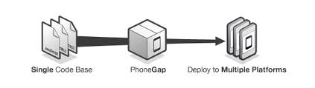
Features of PhoneGap
The features of PhoneGap are, you create your application using HTML5 CSS & JavaScript and Phonegap will wrap your application for the appropriate mobile platform and deploy it to the appropriate app store.

Slide 5
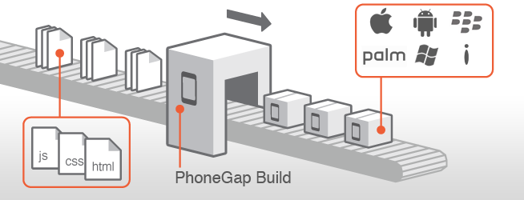
Features of PhoneGap Continued
PhoneGap also has a cloud based service called PhoneGap Build(PGB)
PGB lets you write your application using HTML5 CSS and JavaScript then when you send it to PGB they do all the hard work for you using the most up to date SDK for the platform you are targeting.

Slide 6
PhoneGaps Limitations
PhoneGap free to download, however PhoneGap only provides the open source capability to a developer one time, assuming a developer wants to create more than one application, a monthly fee ($12 for a starter) will be incurred.
PhoneGap also does not support cappuccinno functionality which provides developers the facility functions like drag, drop, copy, paste etc.

Slide 7



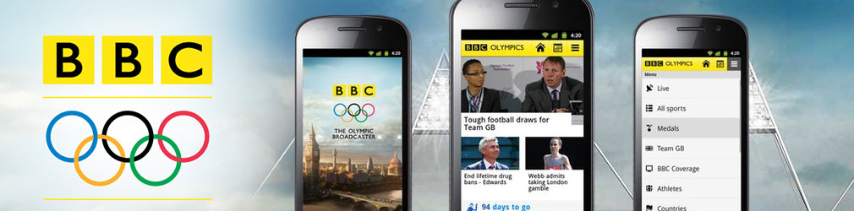

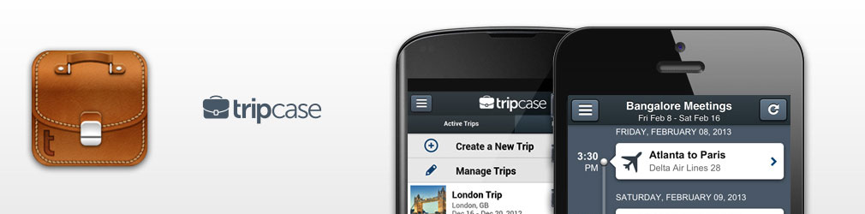
Examples of Usage
Applications developed using the PhoneGap framework include...

Slide 8
Other Frameworks
Other JavaScript frameworks include...
EnyoJS.com
Titanium
Ember
Backbone

Slide 9
Why PhoneGap?
Once discovered I found PhoneGaps websites interface appealing, informative and easy to understand.
Compared to other websites which I found a little vague did not go into too much detail and even contacting developers via twitter while polite not very helpful.

